Slide 1



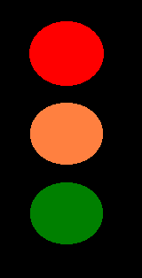

What are these symbols
No Entry
Radioactive
No smoking
Traffic Lights
Corrosive Liquid

Slide 2
Your Task
You have 3 minutes to produce by hand a symbol to display in a park for “No Blading/Skating”

Slide 3
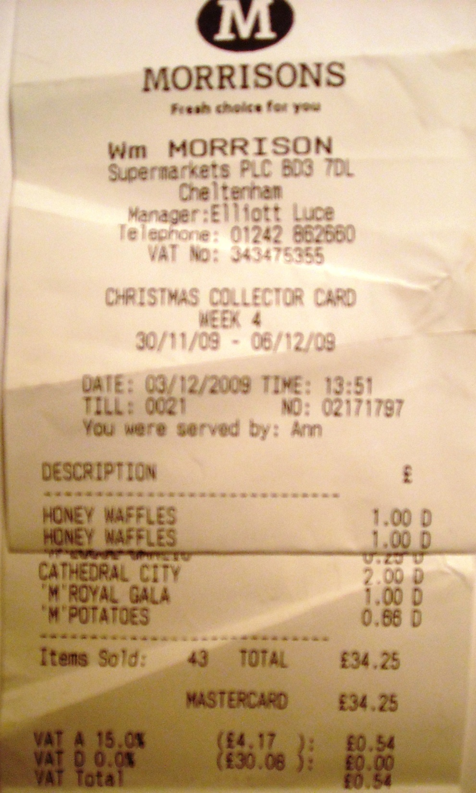
Till receipt
What information do you need on a till receipt ?

Slide 4
More PowerPoint
Hyperlinks
Inserting pictures and video
Slide Master
  Modify a standard supplied on

